Slide 1
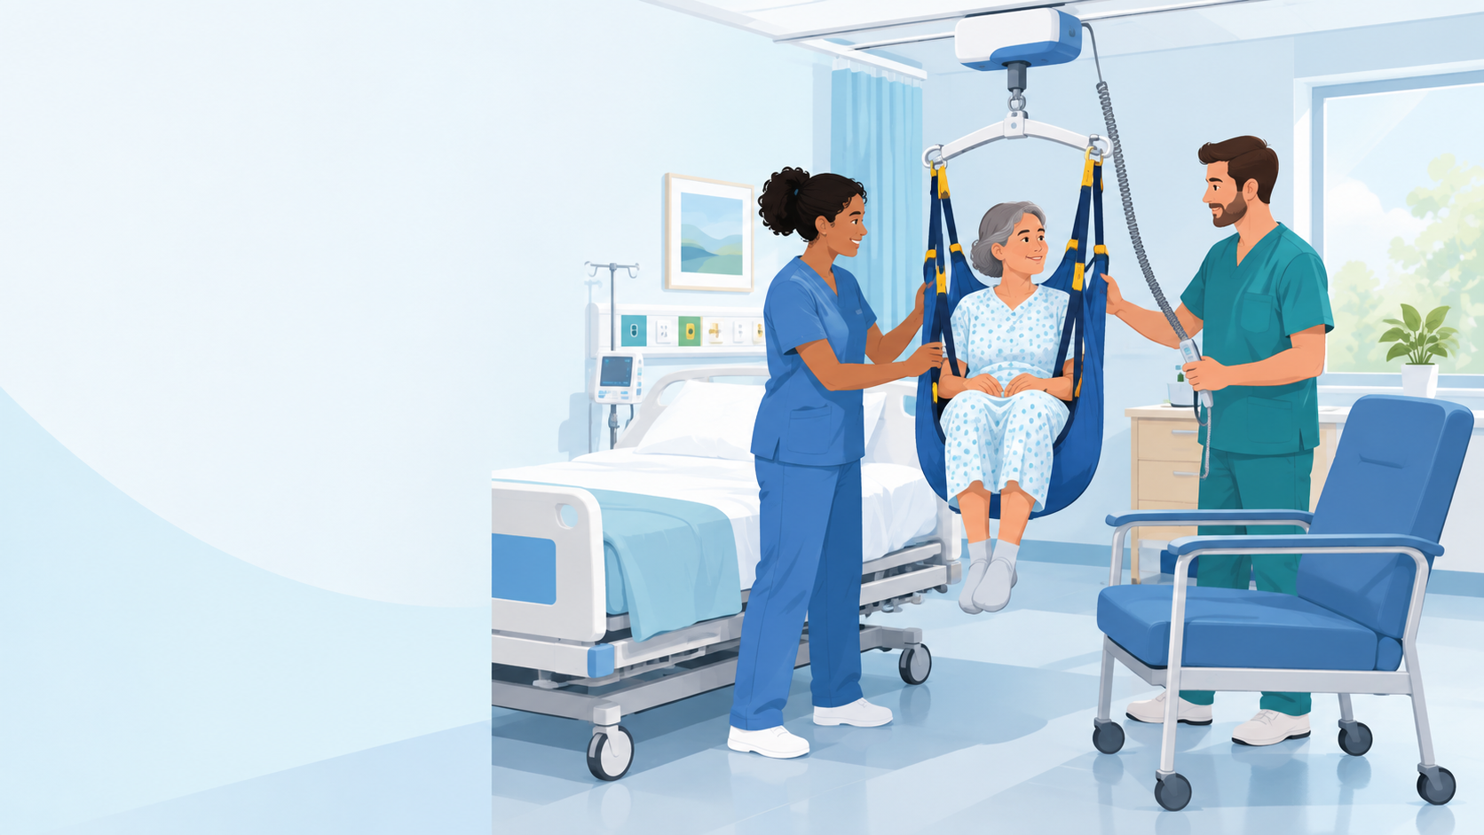
NEW NURSE ORIENTATION
Safe Patient Handling and Mobility
Directive, concepts & policies
Daniel Agbogidi, BSN, RN
Safe Patient Handling & Mobility Program Manager
VA Central California Health Care System
Notes:
Welcome. I'm Daniel Agbogidi, the Safe Patient Handling and Mobility (SPHM) Program Manager.
In this session:
- The directive and local policy behind SPHM
- Why patient handling injures caregivers, and how injuries build up over time
- The high-risk tasks and risk factors to watch for
- What to do when a Veteran refuses equipment, and who to ask for help

Slide 2
SPHM is required, nationally and locally
1
2
VHA Directive 1611
Makes Safe Patient Handling and Mobility a Veterans Health Administration priority. Every VA medical facility must run an SPHM program.
Medical Center Policy 118-21-013
Sets the Safe Patient Handling and Mobility policy for VA Central California Health Care System (VACCHS).
35 lb
Employees must use SPHM technology for routine and urgent tasks that lift more than 35 lb of patient weight, or that need excessive force, such as repositioning a Veteran in bed by pushing or pulling, or supporting a Veteran during mobility.
Notes:
SPHM is of nationwide importance, and it's required.
1. VHA Directive 1611 establishes SPHM as a Veterans Health Administration priority. Every VA medical facility must implement an SPHM program, and SPHM technology must be built into the design of new construction and renovations. The goals: protect health care workers and Veterans from handling injuries, and give every Veteran equitable access to SPHM technology.
2. Locally, Medical Center Policy 118-21-013 sets the SPHM policy for VA Central California.
The line to remember from the directive: employees MUST use SPHM technology for routine and urgent patient handling tasks that require lifting more than 35 lb of patient weight, or that require excessive force, such as repositioning a Veteran in bed by pushing, pulling or supporting them during mobility.
[Optional: play the ANA safe patient handling video here: https://youtu.be/Bss2VEvrdcw]

Slide 3
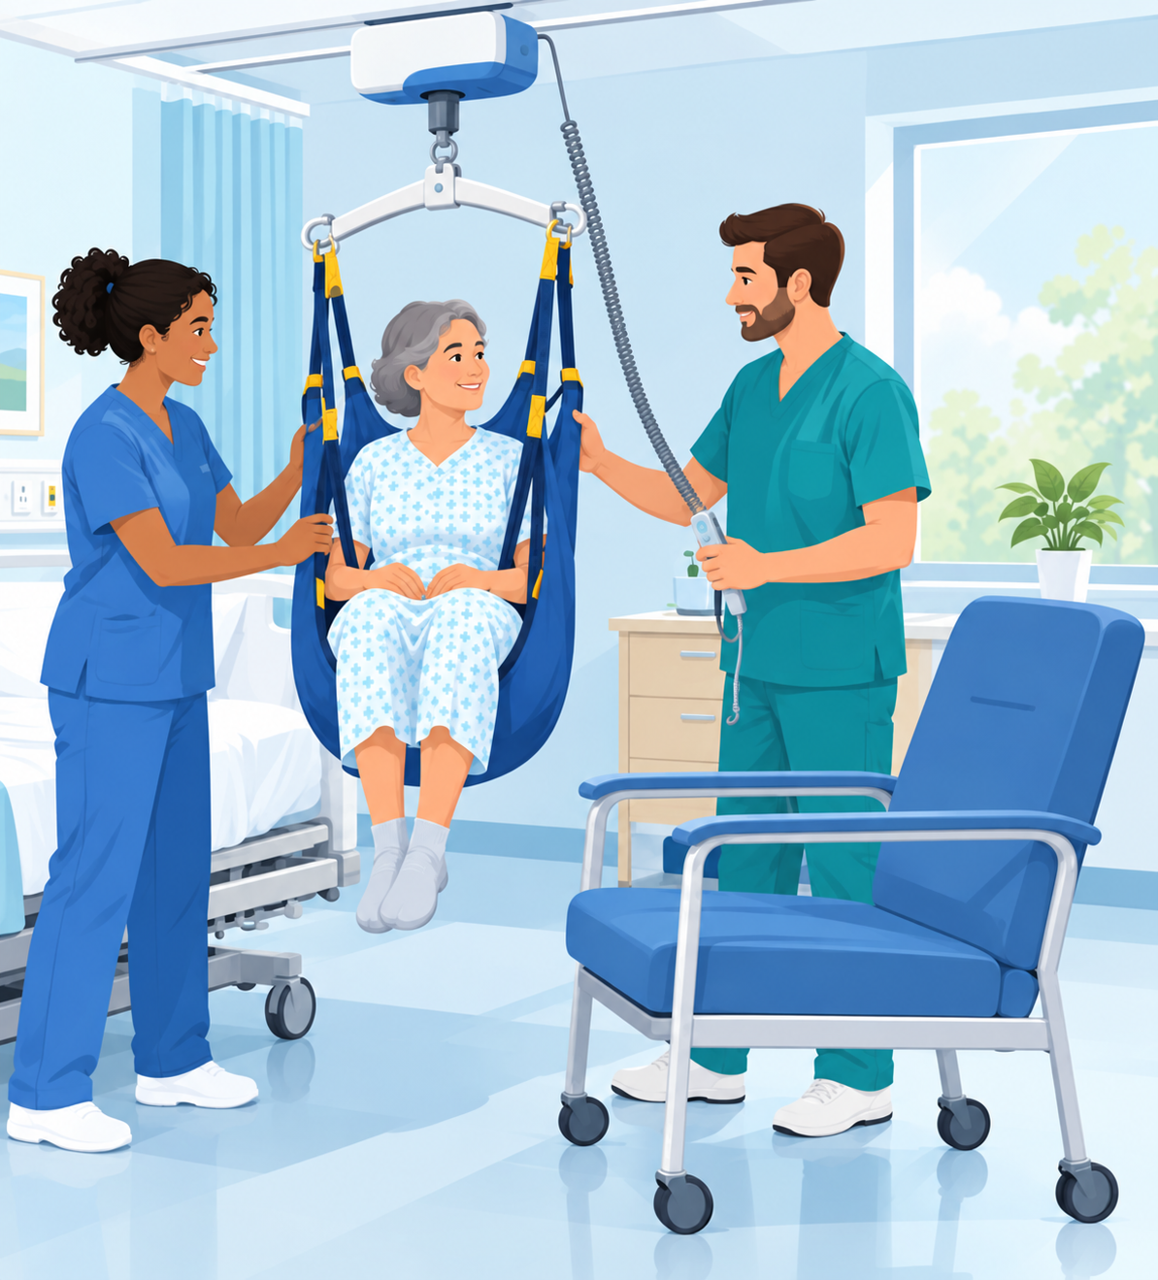
The purpose of the SPHM program
Protect staff
Reduce the risk of work-related injury from patient handling and mobility tasks.
1
Protect patients
Reduce the risk of patient injury during the same tasks.
2
Notes:
The SPHM program has two purposes:
1. Reduce the risk of work-related injury from patient handling and mobility tasks.
2. Reduce the risk of patient injury from those same tasks.
Why it matters: health care workers are at very high risk for injury, and according to OSHA, manual patient handling is the primary driver. In 2017, nursing assistants were second only to laborers and freight, stock and material movers in the number of musculoskeletal cases.
Illustration suggestion: a nurse and a Veteran smiling together as a ceiling lift gently raises the Veteran from bed to chair, both protected.

Slide 4
The cost to caregivers
52%
of nurses report low back pain, and 83% of them keep working through it
#1
Lifting injuries are the top cause of lost workdays for CNAs and other health techs nationwide
38%
of nurses and CNAs are affected by musculoskeletal injuries (ANA), leading to light duty, absences or long-term disability
Notes:
What these injuries cost the people who do the lifting:
- 52% of nurses report low back pain, and 83% of them keep working despite the pain.
- Lifting injuries are the number one cause of lost workdays for CNAs and other health tech professions nationwide.
- According to the American Nurses Association, musculoskeletal injuries affect 38% of nurses and CNAs. The result: light duty, absences and long-term disability.
These injuries end careers. The equipment exists so they don't have to.

Slide 5
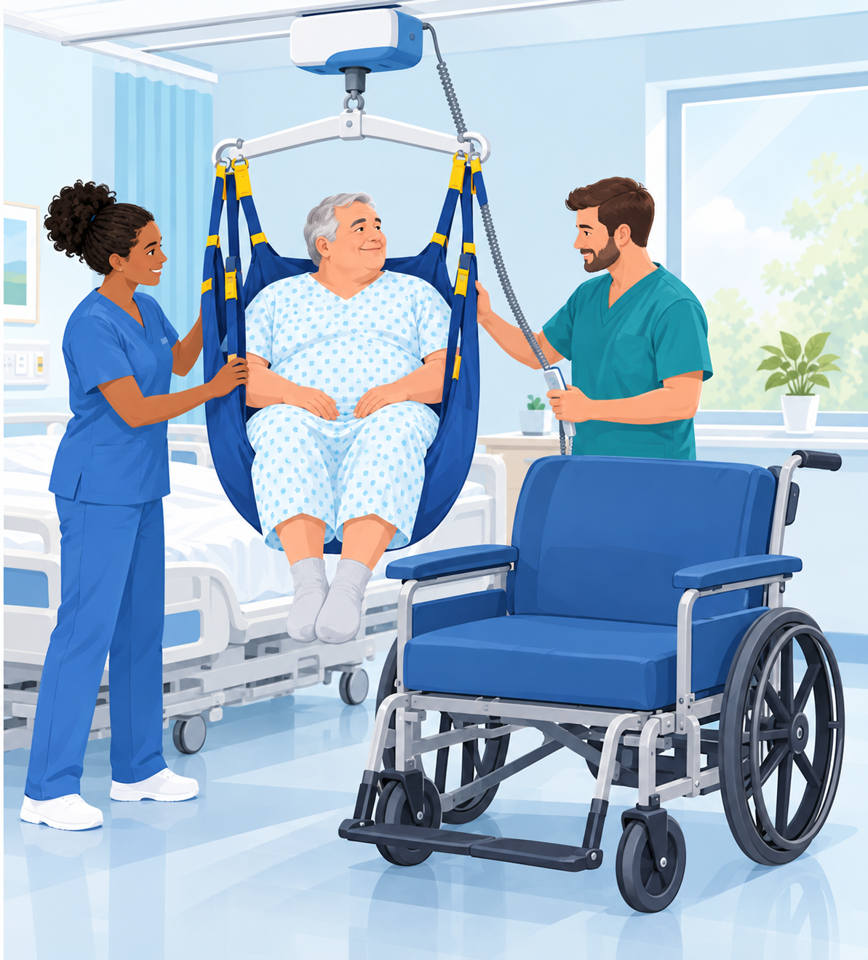
Bariatric patient handling
10%
Patients with a BMI over 35 make up about 10% of the patient population...
...but handling them accounts for:
29.8%
of injuries
27.9%
of lost time
37.2%
of light-duty time
Notes:
Bariatric patients carry an outsized share of the risk. Patients with a BMI over 35 make up about 10% of the patient population, but handling them accounts for 29.8% of injuries, 27.9% of lost time and 37.2% of light-duty time.
Why?
- Most facilities weren't designed for larger patients.
- Lifting and repositioning are harder, and there's less space to work.
- Old manual methods require too much force.
Use bariatric-rated lifts, slings and air-assisted devices, and get enough staff. Never attempt a manual bariatric transfer.
Illustration suggestion: two staff using a bariatric ceiling lift and large sling to move a larger Veteran from bed to a bariatric wheelchair, in a roomy, well-lit patient room.

Slide 6
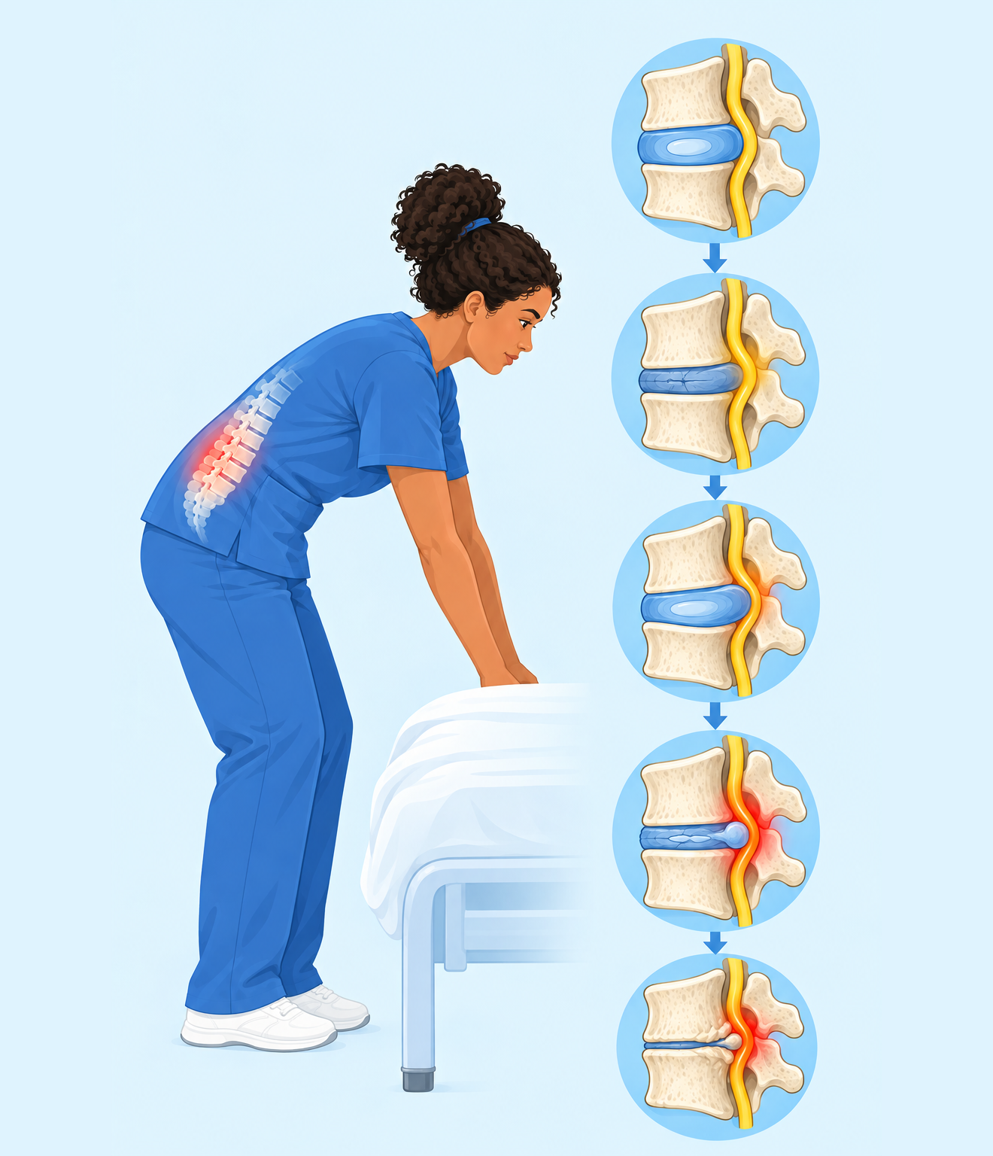
Musculoskeletal disorders build silently
An MSD is an injury to the muscles, bones, joints, tendons, ligaments, nerves, cartilage or spine.
1
Mostly chronic
Most patient handling MSDs build up over years of repeated strain.
2
Back, neck, shoulders, arms
The areas hit hardest by lifting and repositioning.
3
No pain until it's severe
Cumulative microtrauma can do serious damage before you feel it.
Notes:
A musculoskeletal disorder (MSD) is an injury to the musculoskeletal system: muscles, bones, joints, tendons, ligaments, nerves, cartilage and the spine. It can happen suddenly, but most patient handling MSDs develop chronically, over a long period, and affect the back, neck, shoulders and upper limbs.
Cumulative trauma doesn't cause pain until severe injury has occurred. Picture a spine going from a normal disc, to a degenerated disc, a bulging disc, a herniated disc, and finally disc degeneration with bone spurs. How much pain does that person feel at each stage? Possibly much less, or much more, than you'd expect. How would your back feel at each of these stages?
Reference: FGI, Patient Handling and Mobility Assessments: https://www.fgiguidelines.org/wp-content/uploads/2019/10/FGI-Patient-Handling-and-Mobility-Assessments_191008.pdf
Illustration suggestion: a side view of a lumbar spine in the same flat style, showing a healthy disc progressing to a bulging and then herniated disc, next to a nurse reaching to lift.

Slide 7
Your spine is a lever
When you bend at the waist, it becomes the fulcrum and your back becomes the lever. The load on your low back can be 10 times the weight in your hands, plus your own body weight.
Stress on a 150-lb caregiver's low back when turning a patient side to side (34–36 inch reach)
100-lb patient
1,002 lb
150-lb patient
1,314 lb
200-lb patient
1,695 lb
250-lb patient
2,024 lb
Turning counts too. Even a small patient can put over 1,000 lb of force on your low back.
Notes:
Your body and spine act as levers and fulcrums when you lift. A fulcrum is the point a lever rests on. Levers let you lift much more than you could otherwise, but they also multiply the load on your body.
If your back is the lever and your waist is the fulcrum, the weight on your low back can be about 10 times the weight you're lifting. That doesn't include your own body weight, which you're also lifting. Bending, twisting and other awkward postures make it worse.
The maximum any health care worker should lift is less than 35 lb, and turning counts. If a 150-lb caregiver turns a patient side to side with a 34–36 inch reach, the stress on the low back is:
- 100-lb (small) patient: 1,002 lb
- 150-lb (average) patient: 1,314 lb
- 200-lb patient: 1,695 lb
- 250-lb (large) patient: 2,024 lb
Health care workers are the only occupation that believes 100 pounds is light!
Reference: Illinois Wesleyan University back safety handout: https://www.iwu.edu/physical-plant/tailgate/no-month-handouts/back-safety.pdf

Slide 8
High-risk patient care activities
Transferring
Lifting
Weighing
!
!
!
Repositioning
Boosting up in bed or chair
Bathing
!
!
!
Dressing and undressing
Feeding
Putting on TED stockings
!
!
!
Working in awkward positions
Working in confined spaces
!
!
Red: the highest-force tasks. Use equipment for these every time.
Notes:
These patient care activities are considered high risk:
- Transferring, lifting, weighing and repositioning a patient
- Pulling a patient up in a chair or bed
- Bathing, dressing and undressing a patient
- Feeding a patient
- Putting TED stockings on a patient
- Providing care in awkward positions or confined spaces
The first five carry the highest forces. There's equipment for almost every one of these tasks. Ask your Unit Peer Leader what your unit has.

Slide 9
Why patient handling is high risk
1
Patient factors
2
Worker factors
Bulky, with no handles, and can't be held close
Fragile and easily injured if dropped
Larger, sicker and more dependent than before
May be confused or unaware of their mobility limits
Early mobility is now expected to reduce adverse events and length of stay
Awkward, bent or twisted postures for long periods
Help from co-workers isn't always available
Many lifts per shift cause fatigue and exceed safe limits
An aging workforce
Incomplete hand-off communication about mobility
Notes:
Patient factors that make handling high risk:
- Patients are bulky, have no carrying handles, and can't be held close to the body.
- Patients are delicate and prone to injury if dropped.
- Patients are larger and more debilitated than they used to be, and sicker and more dependent on staff.
- Patients may be confused, or may not know their own mobility status.
- Early mobility is now expected, to reduce adverse events and shorten length of stay.
Worker factors:
- Awkward posture for long periods, and many tasks that need a bent or twisted back.
- Co-worker help isn't predictable.
- Many lifts per shift cause fatigue and can exceed safe limits.
- An aging workforce.
- Inaccurate hand-off communication, and changes in working conditions over recent decades.

Slide 10
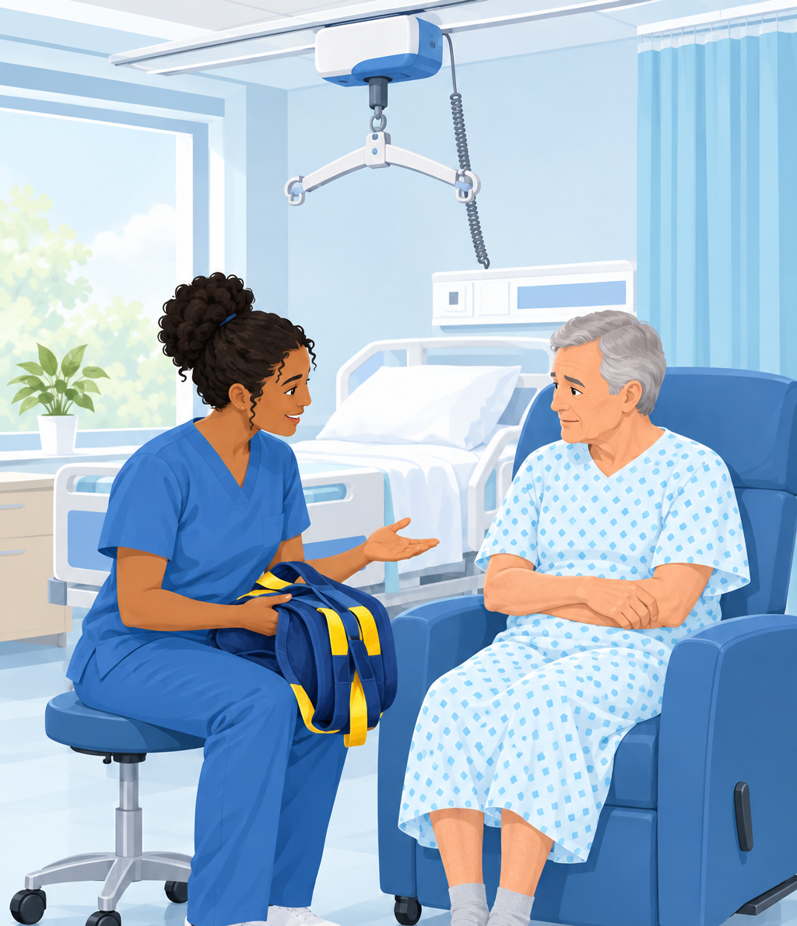
When a Veteran refuses SPHM equipment
A patient can refuse care, but can't require staff to provide care in an unsafe way.
1
Discuss
Find out why the Veteran doesn't want to use the equipment.
2
Document
Record the refusal and every option offered in a nursing note. Pass any solution on to the next shift.
3
Escalate
Involve your Unit Peer Leader or unit management, then the SPHM Program Manager.
4
Management explains
If all safe methods are refused, a safe method must be used per policy, or the care can't be provided.
Notes:
Except in very specific circumstances, any patient can refuse care. But a patient can't demand that staff provide care in an unsafe manner. If a Veteran refuses SPHM equipment:
1. Discuss it. Try to find out why they don't want to use the equipment. Fear, pain and past bad experiences are common reasons, and often fixable.
2. Document it. Record the refusal carefully in a nursing note, including every option offered and refused. If you find a solution, document it and pass it on to the following shifts.
3. Escalate it. Bring in your Unit Peer Leader or unit management to find an alternative. If they can't, they escalate to the SPHM Program Manager.
4. If the Veteran refuses all safe methods, management explains to the Veteran that staff aren't allowed to use methods that could endanger their own or the Veteran's safety, and that a safe method must be used, per policy, or the care can't be provided.
Illustration suggestion: a nurse sitting at eye level with an older Veteran in a chair, calmly explaining a ceiling lift sling she's holding, with the lift visible behind them.

Slide 11
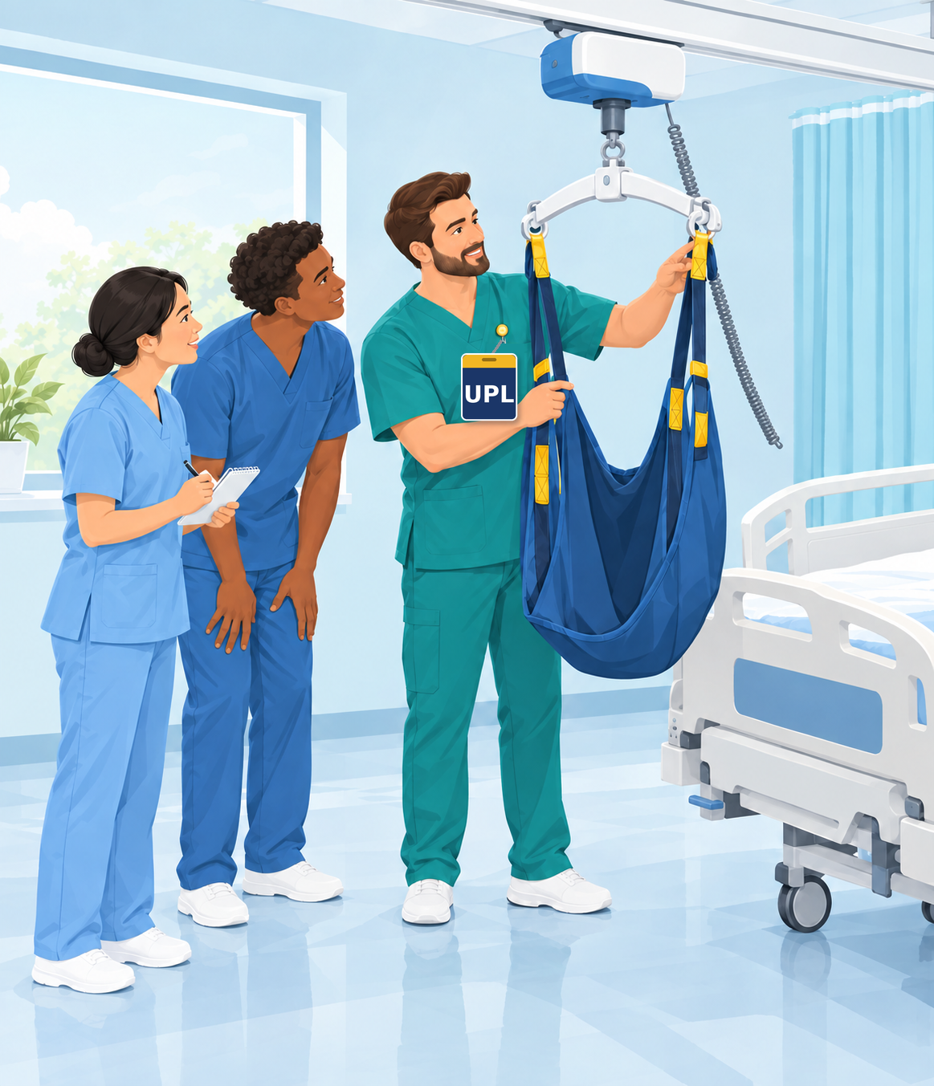
Your Unit Peer Leaders
Every unit has Unit Peer Leaders (UPLs) with extra training in SPHM equipment and technology. They:
✓
Help with ergonomic assessments
✓
Sign off clinical skills competencies
✓
Teach SPHM when it's needed
✓
Pass needs to unit management and the Program Manager
WHO TO ASK
Unit Peer Leader
Unit management
SPHM Program Manager
Notes:
Who can you direct questions to?
Every unit has leaders with extra training in SPHM equipment and technology: the Unit Peer Leaders, or UPLs. The UPL:
- Helps with ergonomic assessments
- Signs off clinical skills competencies
- Provides education on SPHM issues when needed
- Communicates needs to unit management and the SPHM Program Manager
If you can't find a UPL, contact unit management. If unit management can't help, contact the SPHM Program Manager.
Illustration suggestion: a Unit Peer Leader with a badge demonstrating a sling and ceiling lift to two new nurses at a bedside.

Slide 12
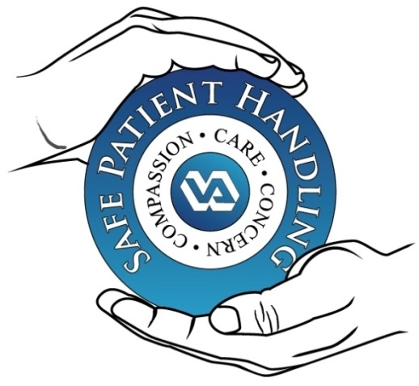
Take the time. Save your spine.
Use the SPHM equipment, every time.
Do not lift more than 35 lb of patient weight.
Thank you! · Daniel Agbogidi, BSN, RN, SPHM Program Manager
Compassion · Care · Concern
Notes:
Take the TIME. Use the Safe Patient Handling equipment to save your spine.
Remember: do not lift more than 35 lb of patient weight. Turning and repositioning count.
Key takeaways:
- SPHM is required by VHA Directive 1611 and local policy MCP 118-21-013.
- Injuries build silently. By the time it hurts, the damage is done.
- A Veteran can refuse care, but not demand unsafe care. Discuss, document, escalate.
- Your Unit Peer Leaders are your first stop for questions.
Thank you. Questions?

